Slide 1
Biodiversity in National Parks
Introduction:
In this project, we will interpret data from the National Parks Service about endangered species in different parks.
We will analyse and plot data and find patterns between species and conservation statuses and also investigating the types of species distributed in different parks.

Slide 2
Describing the data:
We have two csv files as our data: 1) species_info.csv that described in species variable
2) observations.csv that described in observations variable.
columns of species:
category: class of animal
scientific_name: the scientific name of each species
common_name: the common names of each species
conservation_status: each species’ current conservation status
columns of observations:
scientific_name: the scientific name of each species
park_name: Park where species were found
observations: the number of times each species was observed at park

Slide 3
Next, we find the shape of the tables, where species have 4 columns and 5824 rows and observations have 3 columns and 23296 rows.
In data we have 5541 species of biodiversity and 7 categories that are: (Mammal, Bird, Reptile, Amphibian, Fish, Vascular Plant and Nonvascular Plant) and they’re grouped according to their number, Vascular plant at the most with 4470 and Reptile at the leat with 79.
Also we have 4 conservation statuses that are: (Species of Concern, Endangered, Treatened, In Recovery) and they’re grouped according to their number and Species of Concern at the most with 161 and In recovery at the leat with 4 but most of them (5633) no information.
After that we analyse parks from observations that we have 4 parks with these names: (“Great Smoky Mountains National Park, Yosemite National Park, Bryce National Park and Yellowstone National Park) and in total we have 3314739 observations.

Slide 4
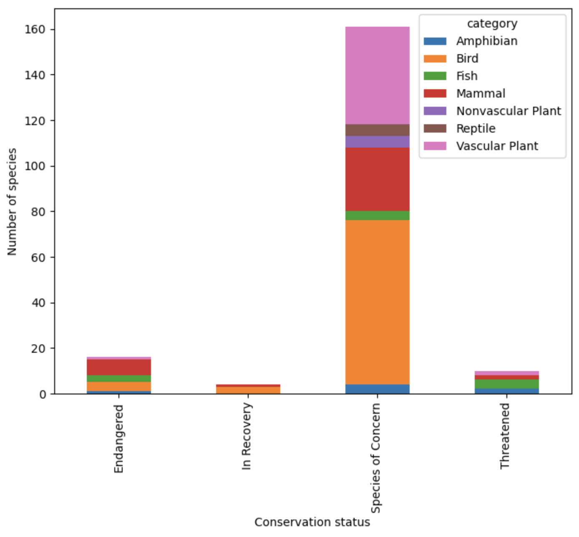
We want to find the relationship between conservation statuses and number of pieces in each category:
At first we make table that columns are categories and rows are conservation statuses and then we can plot a stacked bar for this table.
According to this chart, we can get these results:
Most of species are in the Species of Concern of
conservation statuses and also this status contains all
of the categories.
The most number of species in Species of Concern is
Bird and Vascular Plant , in Endangered is Mammal, in
In recovery is Bird and in Threatened is Fish.
The least number of species in Endangered, Species
of Corner and Threatened statuses is Amphibian.
Only two categories (Bird, Mammal) are in the
In Recovery.

Slide 5
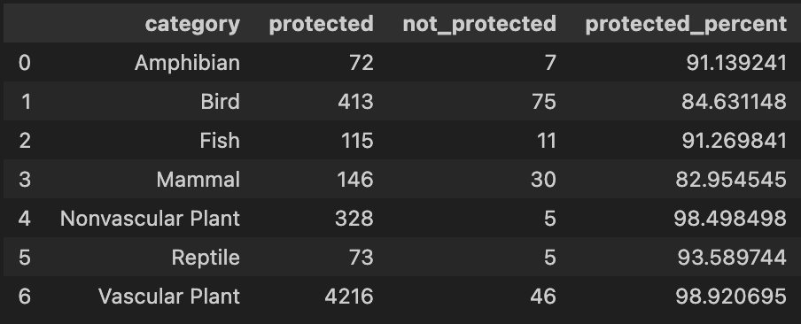
Next, we want to find the answer to this question: certain types of species are more likely to be endangered?
At first, creating a new column called protected and include any species that had a value other than “No Intervention”.
After that, we create a table showing how many of each category are protected and how many aren’t protected and we see that Birds, Vascular Plants, and Mammals have a higher absolute number of species protected.
Also add a column that calculates the protected percentage for each row(category).

Slide 6
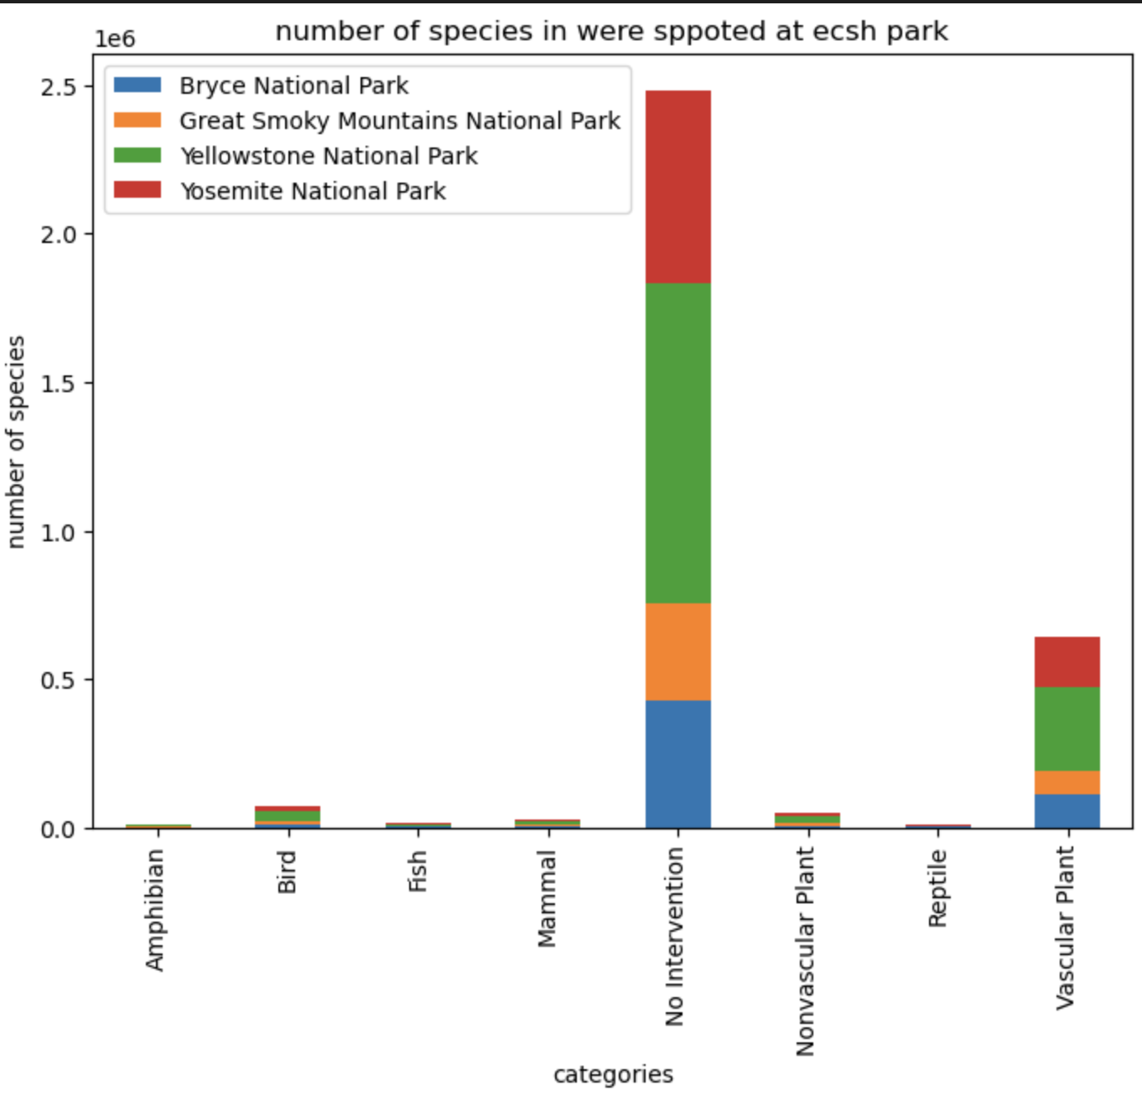
At the end, we want find the number of species in were spotted at each park
At first we make table that columns are parks and rows are categories and then we can plot a stacked bar for this table.
According to this chart, we can get these results:
Most of categories are in the Yellowstone
National Park and then, in Yosemite National Park.
The largest number of species in categories has
no intervention title, but after that the category
of vascular plant is the most category that are in
parks.
The number of Amphibian, Fish, Mammal and
Reptile in National Parks is very low and close
to zero.

